Slide 1
Biological and Artificial Neurons
Michael J. Watts
http://mike.watts.net.nz

Slide 2
Lecture Outline
  Biological Neurons
  Biological Neural Networks
  Artificial Neurons
  Artificial Neural Networks

Slide 3
Biological Neurons
  The “squishy bits” in our brains
  Each neuron is a single cell
  Neuron has:
    nucleus
    many processes leading into it
      dendrites
    one process leading out of it
      Axon

Slide 4
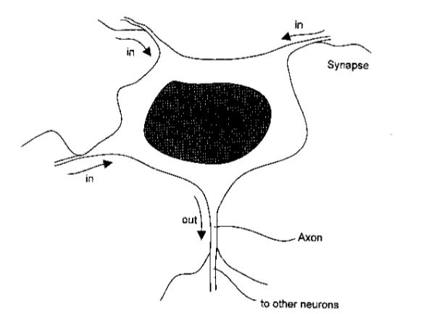
Biological Neurons
From Kasabov, 1996

Slide 5
Biological Neurons
  Axons branch and connect to other neurons and tissues
  Covered in a sheath of myelin
  Gaps in myelin called “nodes of Ranvier”
    accelerate travel of signals

Slide 6
Biological Neurons
  Neurons are electro-chemical
  Electrical potential difference between inside and outside of axon
    inside is negative
    outside is positive
    -70 mV PD inside-outside
      resting potential

Slide 7
Biological Neurons
  Potential difference is due to different concentrations of sodium (Na) and potassium (K) ions
    K inside
    Na outside
  Ion pumps remove Na from the cell while importing K

Slide 8
Biological Neurons
  When the neuron is stimulated, the ion concentrations change
  Causes a change in the potential of the neuron
    decreases the resting potential
  Neuron fires when it reaches a threshold
  Action potential

Slide 9
Biological Neurons
  When the neuron fires, the potential drops down below the resting potential
  After firing, returns to resting potential
  Firing causes a spike of potential to travel along the axon

Slide 10
Biological Neurons
  Spike is caused by ion gates opening in the cell membrane
  Allow Na ions in
  K ions then forced out
  Reverses potential wrt inside and outside
    inside becomes positive
    outside becomes negative

Slide 11
Biological Neurons
  Gates function sequentially along the axon
  Potential returns to normal as ion balance is restored
  Neuron cannot fire again until the resting potential is restored
  Refractory period

Slide 12
Biological Neurons
  A neuron is all or nothing
  It will fire or not fire
  Spike is always the same potential
  Firing can emit a “spike train”
  Frequency of spikes influenced by level of stimulation
    higher stimulation = higher frequency spikes

Slide 13
Biological Neural Networks
  Axons join to other neurons
  Gap between them is called a synapse
  Signals are carried across the gap by neurotransmitters
    e.g. acetylcholine
  Amount of neurotransmitter depends on “strength” of neuron firing

Slide 14
Biological Neural Networks
  Neurotransmitters effect the functioning of the ion pumps
  Excite / inhibit flow of Na ions into the cell
    changes the potential of the neuron
  Neurotransmitters cleaned up by enzymes
    firing of neurons can depend on this as well

Slide 15
Biological Neural Networks
  Synapses can excite the neuron
    excitatory connections
  Synapses can inhibit the neuron
    inhibitory connections
  Different amounts of neurotransmitter are released across each synapse

Slide 16
Biological Neural Networks
  Synapses have different “strengths”
  Synapses that are used more, are stronger
  Hebbian Learning Rule
    proposed by Donald Hebb in 1949
    if two connected neurons are simultaneously activated, then the connection between them will be strengthened

Slide 17
Artificial Neurons
  Abstract mathematical models of biological neurons
  Most don’t attempt to model biological neurons
  First model developed by McCulloch and Pitts in 1943

Slide 18
Artificial Neurons
  McCulloch and Pitts neuron
    a boolean automata
    either on or off
    will fire if the inputs exceed the threshold value
    output is constant
    no time dimension (discrete)

Slide 19
Artificial Neurons
  Most artificial neurons have three things
    an input transformation function
    an activation function
    an output transformation function
  Input transformation functions process the incoming signal
    usually multiply and sum

Slide 20
Artificial Neurons
  Activation functions process the input signal
    linear
    saturated linear
    sigmoid
    tanh
  Output functions process the outgoing signal
    usually linear

Slide 21
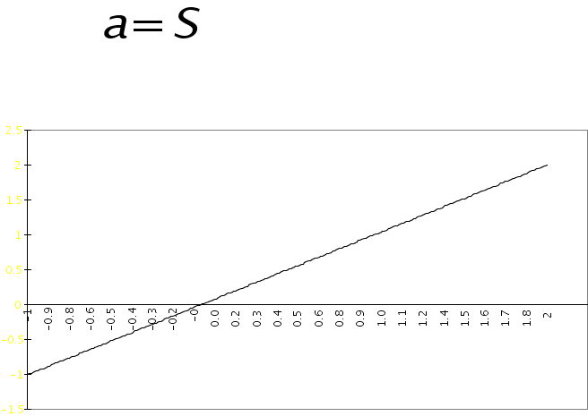
Activation Functions
  Linear
    what goes in is what comes out

Slide 22
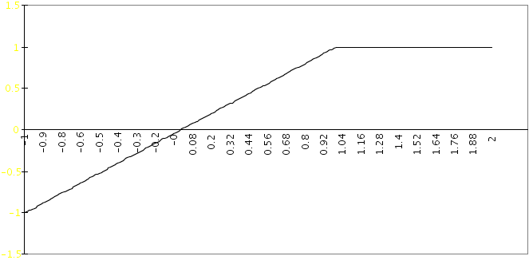
Saturated Linear Activation Function
  Saturated Linear
    linear up to a certain limit

Slide 23
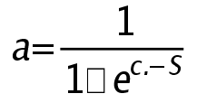
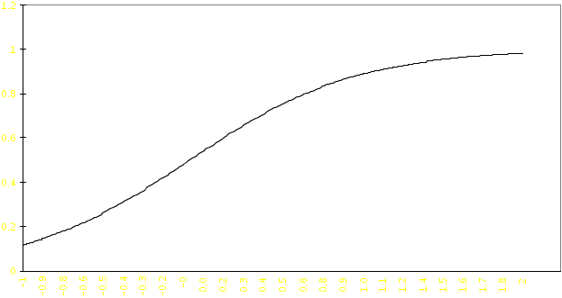
Sigmoid Activation Function
  non-linear function
    limits of 0 and 1

Slide 24
Artificial Neural Networks
  A network of interconnected artificial neurons
  Connections between neurons have variable values
    weights
  Signal is fed through the connections and processed by the neurons

Slide 25
Artificial Neural Networks
  Multiply and sum operation
    performed when a neuron is receiving signal from other neurons
    preceding neurons each have an output value
    each connection has a weighting
    multiply each output value by the connection weight
    sum the products

Slide 26
Artificial Neural Networks
  Learning in ANN is the process of setting the connection weights
    multi-parameter optimisation problem
  Biggest advantage of ANN
    learning from data
  No need to know specifics of process
    cf rule based systems

Slide 27
Artificial Neural Networks
  Learning can be of two types
    supervised
    unsupervised
  Supervised learning
    learning algorithm will try to match known outputs
    requires known outputs

Slide 28
Artificial Neural Networks
  Unsupervised learning
    learning algorithm will try to learn structure of data
    no known outputs required

Slide 29
Artificial Neural Networks
  Knowledge is stored in connection weights
  ANN are also called connectionist systems
  Knowledge can be discovered using ANN
    usually via rule extraction
    analysis of performance can also help
  “Black-box” character biggest drawback to using ANN in systems

Slide 30
Artificial Neural Networks
  Many kinds in existence
  We will be covering only three
    Perceptrons
    Multi-layer Perceptrons (MLP)
    Kohonen Self-Organising Maps (SOM)

Slide 31
Artificial Neural Networks
  Which networks are used depends on the application
  perceptrons useful for simple problems
    linear separability
    supervised learning
  MLPs handle problems perceptrons cannot
    non linearly separable
    supervised learning

Slide 32
Artificial Neural Networks
  SOMs find clusters in data
    unsupervised learning
  Care must be taken with the data used to train the network
    It is easy to badly train an ANN
  Other circumstances where ANN don’t function well

Slide 33
Summary
  Biological neurons are specialised cells
  Emit signals in response to stimulation
  Relatively complex cells
  Biological neural networks are extremely complex
    huge number of connections
  Learning is not entirely understood

Slide 34
Summary
  Artificial neurons are abstractions of real neurons
  Simple mathematical models
  Internal functions vary
  Networks of these neurons are called artificial neural networks
  Knowledge is stored in the connection weightings of these networks

Slide 35
Summary
  Learning in ANN is setting these connection weights
  ANN learn from data
  Many kinds of ANN in existence
  Three popular models
    perceptron
    MLP
    Kohonen SOM

